Slide 1
Homework 2
Made by: John Schueler, Lyly Nguyen, Temi Jolaoso, Marilyne Kouassi, & Kevin Hartanto

Slide 2
Business Question 1:
Which publisher has the highest game sales based on each decade?
Hypothesis:
Nintendo always have the highest sales in gaming industry in the 1980’s, 1990’s, 2000’s, and 2010’s decade.
Notes:
Business Question 1:
Which Publisher has the highest game sales based on each decade.
Kevin: Week 4 R code, 1980 to 1990
John: Week 3 R code, 1990 to 2000
Marilyne: Week 4 R code, 2000 to 2010
Temi: Week 3 R code, 2010 to 2020
LyLy: Slide Aesthetics: (same text size for titles, paragraphs, colors, chart sizes, chart location on page) arrange for congruency
Business Question 2:
What are the video game genres by decade from 1980 to 2020?
Kevin: Week 4 R code, 1980 to 1990
John: Week 3 R code, 1990 to 2000
Marilyn: Week 4 R code, 2000 to 2010
LyLy: Week 3 R code, 2010 to 2020
Temi: Slide Aesthetics: (same text size for titles, paragraphs, colors, chart sizes, chart location on page) arrange for congruency

Slide 3
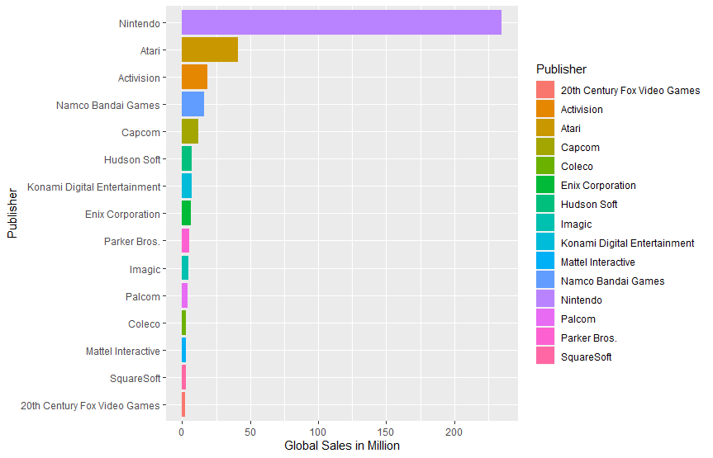
Publisher Sales for 1980 - 1989
1983 the Video Game Industry took a financial hit known as the "Video Game Crash" or the "Atari Shock" this occurred due to the over-saturation of a surplus of over-hyped, low-quality games.
Most publishers became bankrupt or dissolved, but Nintendo was the publisher that was still improving and getting better on building their game. Nintendo tried to design a game for many people able to play the game with a simple task.
Nintendo made their North American debut 1989, becoming the highest-selling in the decade as the console's interchangeable floppy disks and inspiring games like "Super Mario Bros."

Slide 4
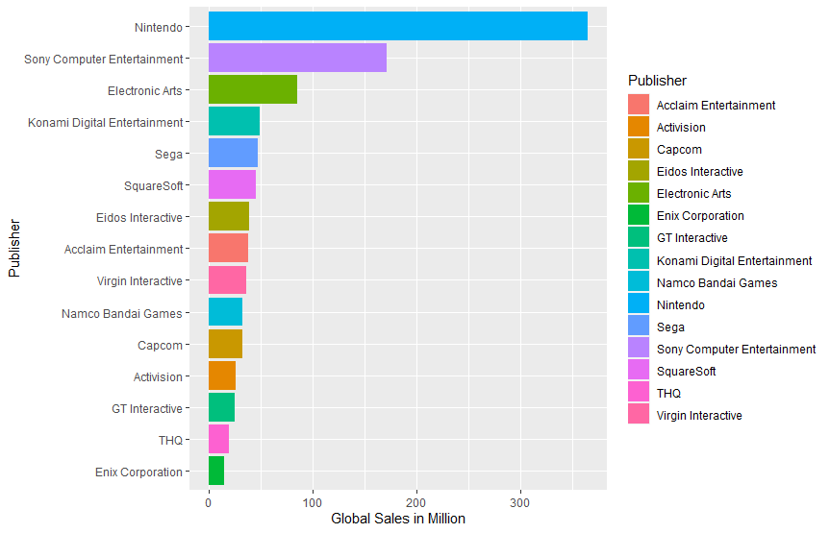
Publisher Sales for 1990 - 1999
In the 1990’s decade, some publishers are rising in terms of global sales, such as Sony Computer Entertainment, Electronic Arts, or Konami Digital Entertainment.
As technology kept improving in the 1990s, many types of games came out. Sony, Electronic Arts, and Konami tried to make a different game with Nintendo, such as fighting games and first-person shooting games.
The introduction of CD consoles such as Playstation helped gain the sales for many publishers except Nintendo because it gave more opportunities for their games to play in these types of consoles.

Slide 5
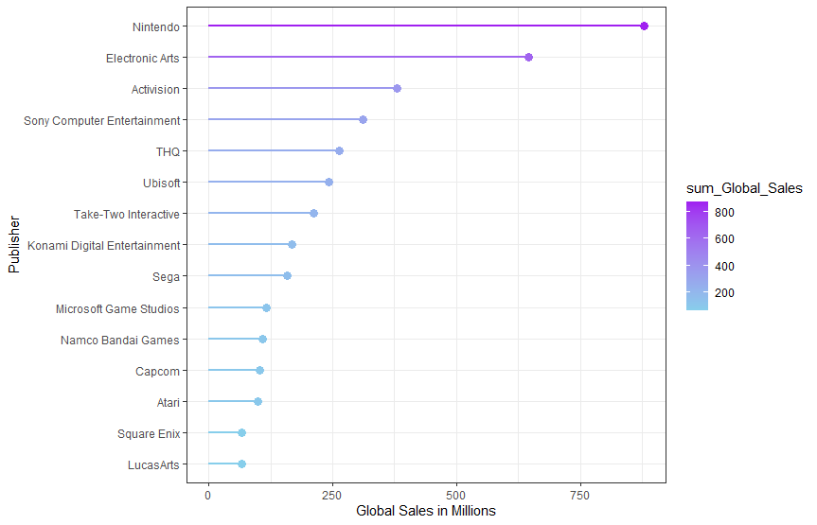
Publisher Sales for 2000 - 2009
At the start of the 2000’s decade, Microsoft and Sony built a trademark console. Microsoft built Xbox, whereas Sony built Playstation.
With the existence of Xbox and Playstation, publishers like Electronic Arts and Activision have the opportunity to have their games played in Xbox and Playstation because most publishers like Electronic Arts and Activision were building a game that was suitable for Xbox and Playstation. The type of game they produced was action, fighting, first-person shooting, and racing, which were unsuitable genres for Nintendo.
In 2006, Nintendo debuted the Wii Technology, which was to compete with Xbox and Playstation. Wii came out with a brilliant idea that would involve body movement for playing the games. Nintendo’s Wii console broke the sales record for a single month in December 2009, leading the console generation in worldwide sales.

Slide 6
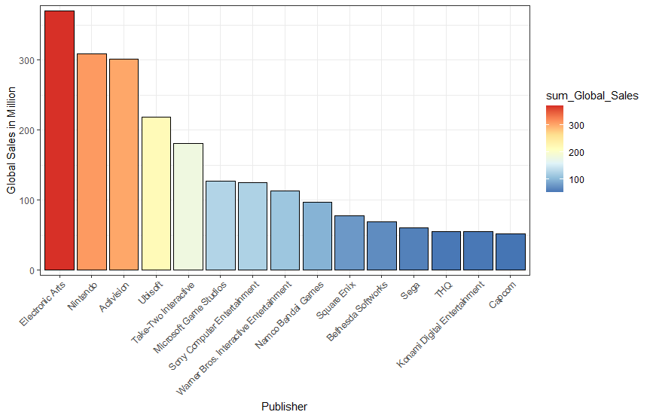
Publisher Sales for 2010 - 2020
In the 2010's decade, video games were getting developed year over year in terms of technology and graphic.
Nintendo announced their next-generation console in 2012, the Wii U, the successor to the Wii. Globally it did not do well, allowing its competitors to gain an upper-hand in the market.
Electronic Arts gained the upper hand with the release of consoles like the PlayStation 4 in 2013, with record sellings in FIFA selling 282.4million copies in 2019.
Nintendo still managed to be in the top three publishers in the decade with its debut of the Nintendo Switch in 2017, with 63 million sales worldwide becoming Nintendo's new hope.

Slide 7
Business Question 2:
What factors may cause fluctuations in critic score trends for violent and non-violent games?
Hypothesis:
That separating video games into 2 separate categories that were violent and non-violent would reveal differences in the trends of critic scores.
Notes:
Business Question 1:
Which Publisher has the highest game sales based on each decade.
Kevin: Week 4 R code, 1980 to 1990
John: Week 3 R code, 1990 to 2000
Marilyne: Week 4 R code, 2000 to 2010
Temi: Week 3 R code, 2010 to 2020
LyLy: Slide Aesthetics: (same text size for titles, paragraphs, colors, chart sizes, chart location on page) arrange for congruency
Business Question 2:
What are the video game genres by decade from 1980 to 2020?
Kevin: Week 4 R code, 1980 to 1990
John: Week 3 R code, 1990 to 2000
Marilyn: Week 4 R code, 2000 to 2010
LyLy: Week 3 R code, 2010 to 2020
Temi: Slide Aesthetics: (same text size for titles, paragraphs, colors, chart sizes, chart location on page) arrange for congruency

Slide 8
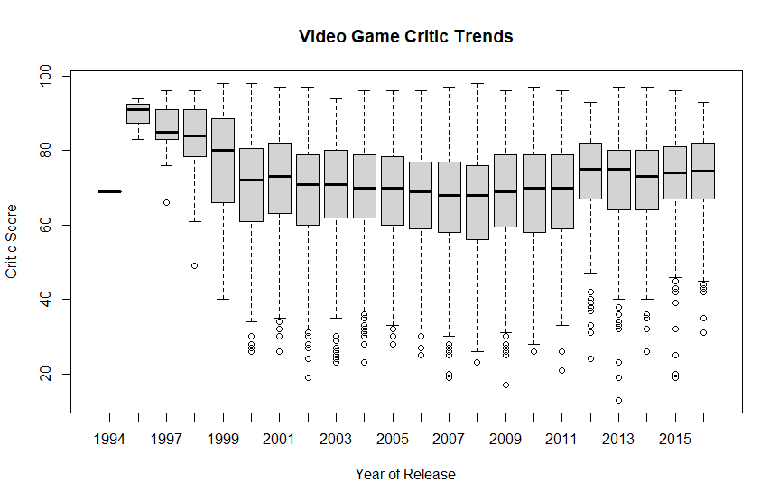
Video Critic Scores from 1980s to 2010s
This boxplot shows the critic scores of video games of all genres from the 1990s to the 2010s.
It shows a sharp decline in the average rating of video game critic scores followed by consistency with relatively little to no fluctuation in contrast to the initial dip.
Insight: A higher standard of video game quality was induced at the millennium that stayed consistent afterward.
*The rating organization for video games, ESRB, was not created until 1994*

Slide 9
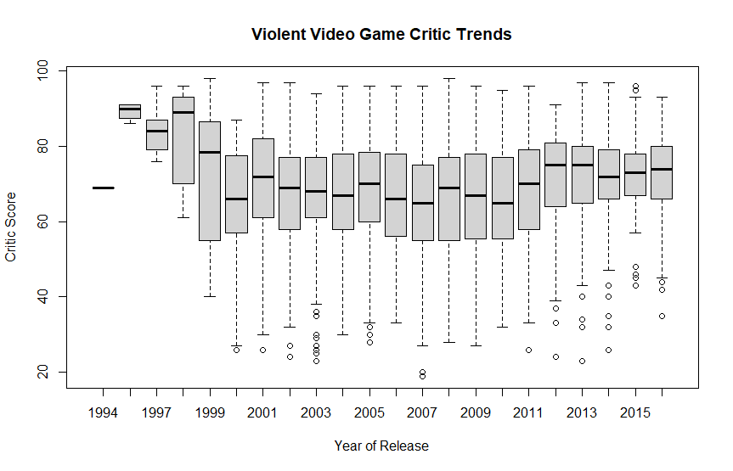
Violent Video Game Critic Trends
We classified violent video games to be Action, Fighting, and Shooter genres.
Action is the top-selling genre of all time, so we assume with such popularity, the average critic score trend would be higher for violent games.
There was a sharp decrease in values in the late 90s with minimal fluctuation from then through the 2010s.
The data shows the most common critic rating to be, on average, around 55 and 80 percent. There are more closely related throughout the years.
*The rating organization for video games, ESRB, was not created until 1994*

Slide 10
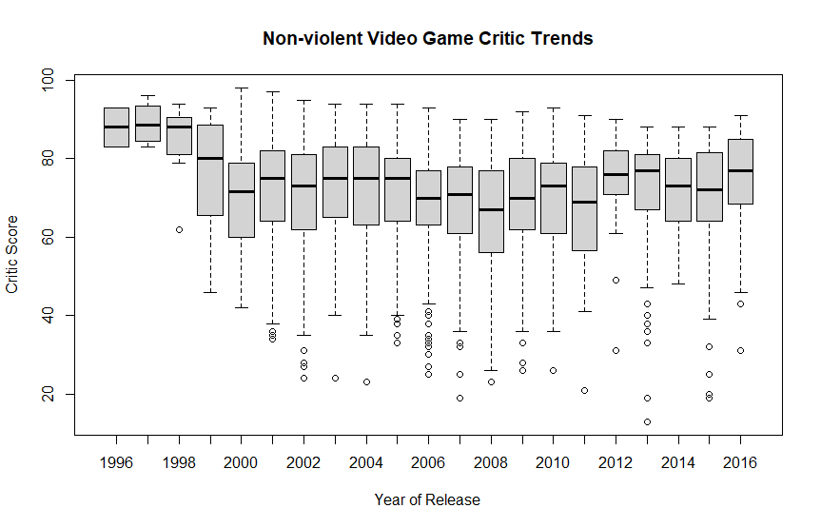
Non-violent Video Game Critic Trends
We classified non-violent games to be Sports, Racing, Puzzle, Simulation, Platform, and Strategy genres.
Non-violent games are characterized by little or no violence. Most of the critic scores are focusing on sports, platform, and strategy.
The data shows the most common critic rating to be, on average, around 60 and 80 percent. There are more lower critic scores compared to the higher scores. The low rating affects their popularity and sales.
*The rating organization for video games, ESRB, was not created until 1994*

Slide 11
Conclusion
Which publisher has the highest game sales based on each decade?
From the decade 1980’s to 2000’s decade, Nintendo was taking over the gaming industry. While Nintendo had the highest sales during that period, many publishers tried to beat Nintendo sales, but they were far behind. As technology and video game graphics were developing year over year, many publishers had produced games with better resolution and made it playable in the advanced console. The 2010’s decade was different because Electronic Arts, Activision, and Ubisoft were taking over the game industry. Although Nintendo still had the largest sales, Nintendo had developed many great technologies such as Switch. Electronic Arts were able to be the highest spot for the largest sales.
What factors may cause fluctuations in critic score trends for violent and non-violent games?
Factors such as the form, style, or subject of games affects critic score trends. Both violent and nonviolent video games critic scores are largely similar, though violent video games have a consistently larger range into the lower scores than non-violent video game critic scores. This suggests that nonviolent video games potentially face fewer critics that may have a consistently negative bias towards the genre of games because of their controversy of the effect it has on its users.
I
N
S
I
G
H
T
I
N
S
I
G
H
T

Slide 12
Reference:
https://en.wikipedia.org/wiki/1980s_in_video_games
https://en.wikipedia.org/wiki/1990s_in_video_games
https://en.wikipedia.org/wiki/2000s_in_video_games
https://en.wikipedia.org/wiki/Entertainment_Software_Rating_Board
https://hiscoga.wordpress.com/nintendo-wii-u-2012-present/#:~:text=The%2520Wii%2520U%2520is%2520a,console%2520to%2520support%2520HD%2520graphics
https://en.wikipedia.org/wiki/FIFA_(video_game_series)

